Slide 1
Template method and bridge design patterns

Slide 2
Template method
The template method design pattern allows the steps of a process or an algorithm to be redefined for different cases. It helps us to standardize a process.
We have an algorithm that we designed to manage a process. This algorithm consists of certain steps. The order of the steps is determined because they are defined in the process. These steps need to have different behavior according to different needs. That is, the skeleton of our algorithm and its flow is clear. It is also clear what each step will do, but how this work is done should be customized according to the cases.
Notes:
This is a straightforward solution for calculating the average of 2 numbers.
Notice the code in lines 3-5, repeated in lines 7-9.

Slide 3
Another possibility could be: Consider that we do not know the content of some steps in the same algorithm steps. We define them as abstract steps. The class we are developing for the process can have both concrete (i.e. defined jobs) and abstract (not yet defined) methods. Abstract methods will be populated later, after implementation. The template method, which gives its name to the design pattern, is the main method that calls both concrete and abstract defined methods.
Please note that we do not abstract the whole process with the template method design pattern. If we were doing that, we would be moving towards the strategy design pattern. Here we are abstracting some methods of an already fixed process. Strategy is a class, and template is a method.
Notes:
This is a straight forward solution for calculating the average of 10 numbers.
Notice now the code in lines 4-6 repeated more than once (3 times to be exact).
In real life, the size of data that programs deal with, is generally huge.
For example:
Bank system calculations
Seeking information on the web.
Image processing
Network traffic monitoring
etc…
It would be impractical to repeat the same few commands dozens, or hundreds or thousands of times.
Programs would become unreadable, error-prone and hard to fix.
There must be another solution for the repetition-of-similar-or-same-code problem!

Slide 4
With the template method pattern, the varying stages of an algorithm are abstracted. The common points are abstracted to the superclass (these methods are called hooks), while the varying points are defined in the subclasses.
This design pattern is used very often. It is a robust refactoring tool. As the dispersed projects grow, Commonality and Variability analysis is made to reshape the structure. For the same processes, abstractions are made using the template pattern.
Notes:
A loop is a mechanism for defining the repetition of a code segment.
Each repetition is called an Iteration.
In this chapter we will learn about the following loop types:
The while loop
The for loop
These are not the only loop types in Python, but they are very common in most programming languages.

Slide 5
Code
We have a simple example. We have an algorithm that determines the money to be deducted from drivers using toll roads. The progress of the process is as follows:
First, read the license plate of the oncoming vehicle.
Then, send the plate to the system and see if there is a subscription record for this plate.
Set the toll.
The two methods would be the same for all cases, except for the determination of the toll. However, the toll varies by service. For example, we may want to do a separate calculation for a bridge crossing and a separate highway crossing. So the last method is left in the parent class as an abstract method. It is filled in the subclasses.
Notes:
A loop is a mechanism for defining the repetition of a code segment.
Each repetition is called an Iteration.
In this chapter we will learn about the following loop types:
The while loop
The for loop
These are not the only loop types in Python, but they are very common in most programming languages.

Slide 6
from abc import ABC, abstractmethod class Ticket(ABC): def method(self): # read plate plate = self.read_plate() # check record record = self.check_record(plate) # decide price price = self.decide_price(record) return price def read_plate(self): return "34 XXX 123" def get_licence(self, plate: str): return 1 @abstractmethod def decide_price(self, record: int): pass
Notes:
The while keyword indicates the use of the while loop.
A condition is checked.
If the condition evaluates to true, a block of commands (enclosed in braces) is executed.
When the program is done executing the block, the condition is checked again.
The block will be executed again and again, as long as the condition
evaluates to true.
As soon as the condition turns to false the block is skipped.

Slide 7
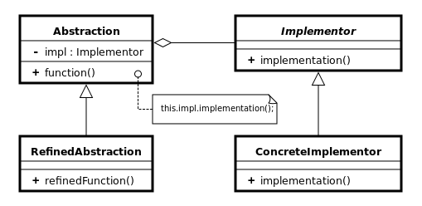
Bridge
There is an is-a relationship between abstraction and its implementation. In this relationship, a dependency is formed between the two parties, namely abstraction, and implementation. If the abstraction changes, implementation has to change too. Interesting point of view, but inheritance is highly coupled. In some cases, we would like to stay away from it. The Bridge design pattern comes to our aid in these situations.
We prefer the has-a relationship over the is-a relationship, composition over inheritance. In this way, the coupling is reduced. Because we no longer do direct inheritance, we prefer to use composition instead. Abstraction and implementation are placed under two hierarchies. has-a relation is established between these two hierarchies.
Notes:
Syntax
while 'condition': //colons at the end of the line to determine the beginning of the loop scope
one or more commands //in a slight indentation to the right
…
The slight indentation to the right defines all the commands meant for repetition into a
repeating block called the loop block (also known as loop body).
Action
The loop continues to iterate as long as the value of the condition is true.
The condition is re-evaluated before each repetition of the loop block.
In this case the condition is (number < 1000) and the loop block is in lines 3-4.
Important
Consider a loop in action.
What makes it stop?
If the program is executing the code in the loop, will it do so “forever”?
For the program to eventually exit the loop the condition must be false at some point.

Slide 8
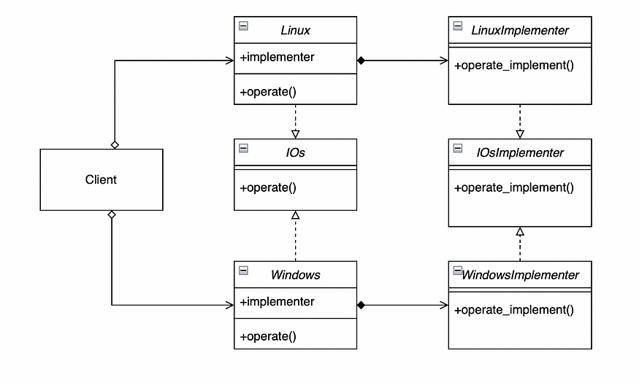
Code
Notes:
The loop block (lines 3-7) consist of:
The commands the programmer wishes to repeat (lines 4-7)
Commands to make changes that will eventually turn the condition from true to false (line 7)
Now that we have the while loop in place, changing the number of times it is repeated (iterates) is very easy.
All we need to do is the change the condition (in this case, line 3) accordingly.
No change in the loop block is needed.

Slide 9
from abc import ABCMeta, abstractmethod class IOs(metaclass=ABCMeta): "The Operating System Abstraction Interface" @staticmethod @abstractmethod def operate(): "will be overridden in implementer" class IOsImplementer(metaclass=ABCMeta): "Os Implementer" @staticmethod @abstractmethod def operate_implement(): """""" class Linux(IOs): def __init__(self, implementer): self.implementer = implementer() def operate(self): self.implementer.operate_implement() class Windows(IOs): def __init__(self, implementer): self.implementer = implementer() def operate(self): self.implementer.operate_implement() class LinuxImplementer(IOsImplementer): def operate_implement(self): print("Sudo!") class WindowsImplementer(IOsImplementer): def operate_implement(self): print("Windows!")
IOs is the abstract interface. Linux and Windows are the refined abstractions. When each OS’s operate method is called, the equivalent method within their implementation is called.
Notes:
In line 8, the loop condition involves size which is known only during run-time.
Therefore, the programmer has no knowledge how many iterations will actually take place.
Question
How many iterations will the while repeat if 0 (zero) is entered as input for size (line 7)?
Answer
0 (zero) times.
This is because the while loop checks the condition counter <= size even before its first iteration.
Since the condition evaluates to false, there will not be even a single iteration of the loop.

